Slide 1


Department of Artificial Intelligence and Data Science
Optimizing Bed Allocation through Advanced Predictive Analytics and Gradient Boosting Technique
Mrs.S.Renuka Devi
AP AI&DS
HARSHITHA R 221801018 VAISHNAVI S 221801059

Slide 2
Problem Statement and Motivation
A healthcare provider aims to optimize hospital bed allocation by analyzing patient admission data and bed occupancy rates.
They aim to improve operational efficiency and patient care. The aim is to reduce the wait times, prevents overcrowding, lowers costs, and improves staff satisfaction by ensuring resources are available where needed.
This data-driven approach is crucial for sustainable healthcare system management.

Slide 3
Objectives
To develop a predictive model using gradient boosting algorithms to optimize hospital bed allocation. The model should forecast patient admission rates and predict the optimal allocation of beds across various departments and wards, aiming to balance patient needs with available resources.
This initiative aims to enhance operational efficiency, reduce patient wait times, and ensure the optimal utilization of beds and staff.
By leveraging data insights, the goal is to improve overall patient care quality, balance staff workload, and decrease operational costs.

Slide 4
Abstract
Hospital bed allocation is a critical aspect of healthcare management that impacts patient care quality and operational efficiency. This project aims to develop a predictive model using gradient boosting algorithms to optimize hospital bed allocation. Implement gradient boosting algorithms such as LightGBM to predict future patient admissions and bed requirements and K-Means clustering to segment patients or operational data into distinct clusters. Utilizing historical data on admissions, bed availability, patient demographics, and operational parameters, the model will enhance bed utilization, patient care, and operational efficiency.

Slide 5
Introduction and Overview of the Project.
Effective hospital bed allocation is crucial for ensuring timely patient care and operational efficiency. This project aims to develop a predictive model using K-means clustering and gradient boosting algorithms to optimize bed allocation.
K-means clustering will segment patients into groups based on demographics and medical needs, providing insights for targeted prediction. Gradient boosting models will then forecast admission rates and bed requirements within each cluster.
By leveraging historical data on admissions, bed availability, and operational constraints, the model will enhance bed utilization, improve patient outcomes, and increase operational efficiency. Continuous monitoring and adjustments will ensure sustained performance improvements.

Slide 6
S.NO | AUTHOR NAME | PAPER TITLE | DESCRIPTION | JOURNAL | VOLUME/ YEAR
1. | Aboagye-Sarfo P, Mai Q, Sanilippo FM, Preen DB, Stewart LM, Fatovich DM | A Comparison of Multivariate and Univariate Time Series Approaches to Modelling and Forecasting Emergency Department Demand | This paper compares multivariate and univariate time series models to predict demand in emergency departments in Western Australia. It explores how each model impacts patient flow management and operational decision-making. | Journal of Biomedical Informatics | 2015
2. | Adan I, Bekkers J, Dellaert N, Vissers J, Yu X | Patient Mix Optimization and Stochastic Resource Requirements: A Case Study in Cardiothoracic Surgery Planning | This study focuses on optimizing patient mix and managing stochastic resource requirements in a cardiothoracic surgery unit. The model assists in planning for resource allocation and improving patient outcomes. | Health Care Management Science | 2009
3. | Ahmed MA, Alkhamis TM | Simulation Optimization for an Emergency Department Healthcare Unit in Kuwait | This research uses simulation optimization techniques to improve patient flow and resource allocation in an emergency healthcare unit. | European Journal of Operational Research | 2009

Slide 7
S.NO | AUTHOR NAME | PAPER TITLE | DESCRIPTION | JOURNAL | VOLUME/ YEAR
4. | Majzoubi F, Bai L, Heragu SS | An Optimization Approach for Dispatching and Relocating EMS Vehicles | This paper presents an optimization model for efficiently dispatching and relocating emergency medical services (EMS) vehicles. The model reduces response times and improves service availability. | IIE Transactions on Healthcare Systems Engineering | 2012
5. | Nezamoddini N, Khasawneh MT | Modeling and Optimization of Resources in Multi-Emergency Department Settings with Patient Transfer | This study models and optimizes resources across multiple emergency departments, with a focus on patient transfers. It aims to enhance operational efficiency and patient outcomes through better resource allocation. | Operations Research for Health Care | 2016
6. | Jang W, Dobrzykowski D, Sarker R | Predictive Modeling for Healthcare Bed Allocation Using Machine Learning Techniques | This paper employs decision tree algorithms and historical patient data to forecast bed demand, aiming to enhance patient care and operational efficiency. | Health Systems | 2019

Slide 8
Existing System
Cerner: Provides comprehensive solutions for managing clinical, operational, and financial resources, including staff scheduling, inventory management, and patient flow.
Epic Systems: Offers an integrated suite of tools for managing patient care, including resource management features such as staffing, equipment tracking, and facility management.
Meditech: Known for its integrated EHR system, Meditech also includes resource management features that cover staff, inventory, and patient flow.

Slide 9
Drawback of Existing System
Complex interface, high cost, steep learning curve.
Expensive, implementation can be time-consuming, can be challenging for smaller facilities.
Less flexible compared to some competitors, slower to adopt new technologies.

Slide 10
Proposed System
The proposed system, Optimizing Bed Allocation through Advanced Predictive Analytics and Gradient Boosting Technique, utilizes advanced machine learning models like Gradient Boosting and K-Means Clustering to forecast patient admissions and optimize hospital bed allocation. By analyzing historical patient data, real-time occupancy rates, and external factors, the system ensures efficient bed distribution across departments, minimizing patient wait times and improving care. Additionally, it streamlines resource management by optimizing staff schedules and balancing workloads, ultimately enhancing hospital operational efficiency and reducing costs

Slide 11
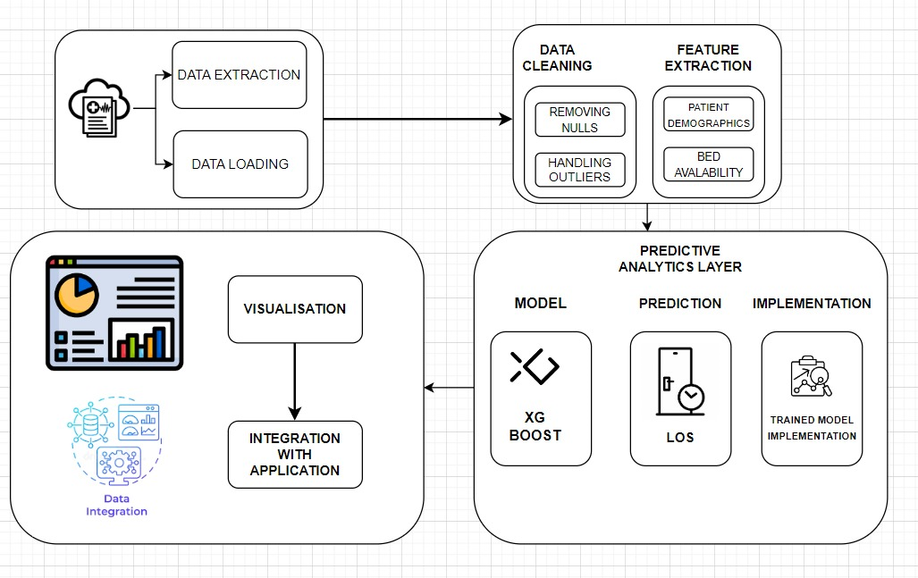
System Architecture

Slide 12
Methodology
The core of XGBoost is based on minimizing an objective function. The objective function consists of two parts:
Loss Function: Measures how well the model's predictions match the true labels.
Regularization Term: Adds a penalty to prevent overfitting by discouraging overly complex models.

Slide 13
Algorithm steps
Step 1: Combine the loss function (measuring prediction errors) and a regularization term (penalizing complexity) to form the objective function.
Step 2: Create decision trees, using gradients to determine the best splits at each node that minimize the objective function.
Step 3: For each tree, update the overall predictions by adding the output from the tree, refining the model's accuracy.
Step 4: Continue building trees iteratively, correcting errors from previous trees until the model reaches a desired performance level.
Step 6: The final prediction is the sum of predictions from all trees, providing a robust output for new input data.

Slide 14
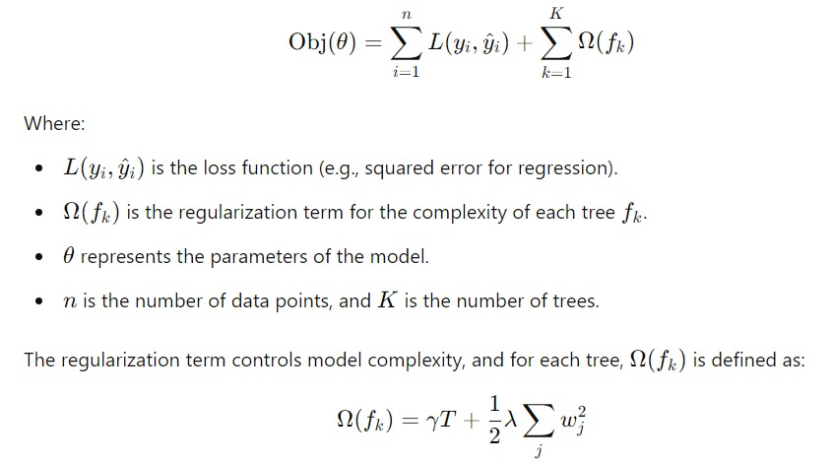
The overall objective function can be written as:

Slide 15
List of Modules
1. Data loading and preprocessing
2. Model selection and training
3. Prediction logic
4. Visualization

Slide 16
1. Data loading and preprocessing
Data Reading: The data is read from a CSV file, which contains patient information such as hospital ).
code, department code, patient ID, age, admission deposit, and the length of stay (target variable
Exploratory Data Analysis (EDA): The correlation between the features is analyzed. This helps in understanding which features are important and how strongly they are related to the target (stay duration). Since the correlation between features is low, advanced machine learning models like XGBoost are chosen.

Slide 17
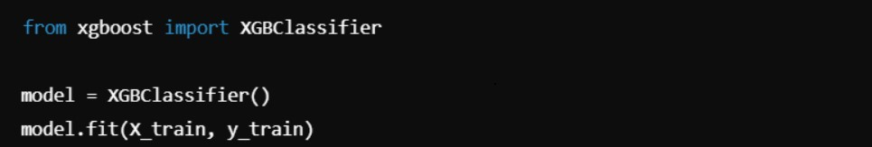
2. Model Selection and Training
XGBoost: This model is an optimized gradient-boosting algorithm that combines weak prediction models (in this case, decision trees) to form a strong predictive model. It does this by iteratively adding trees that correct errors made by the previous trees. Each tree predicts the residual errors of the previous model, and the final prediction is the sum of all tree predictions.
Training: The model is trained on the selected features, where the target variable is the stay duration (i.e., how long a patient is expected to stay in the hospital).

Slide 18
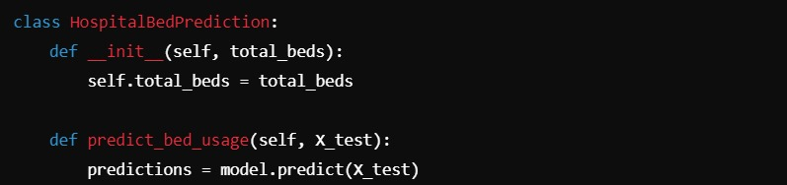
3. Prediction Logic
Simulating Hospital Management: A class is implemented to simulate a real-world scenario of hospital bed management. It randomly selects 20 patients from the test set (X_Test) and uses the trained XGBoost model to predict their stay duration.
Bed Prediction: Based on the predicted stay durations, the model calculates how many extra hospital beds will be needed. This can be adjusted by setting the total_beds value, which represents the total number of beds available in the hospital.

Slide 19
4. Visualization
The results of the prediction are visualized using graphs. This step helps in interpreting how many extra beds the hospital may need, based on the predicted patient stays.

Slide 20
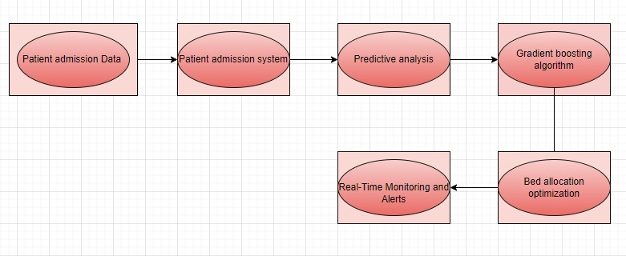
Data flow diagram

Slide 21
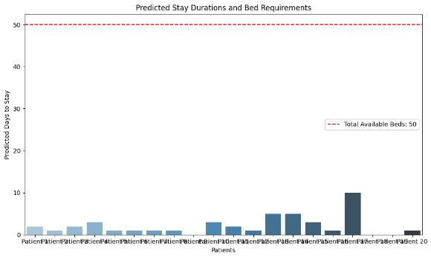
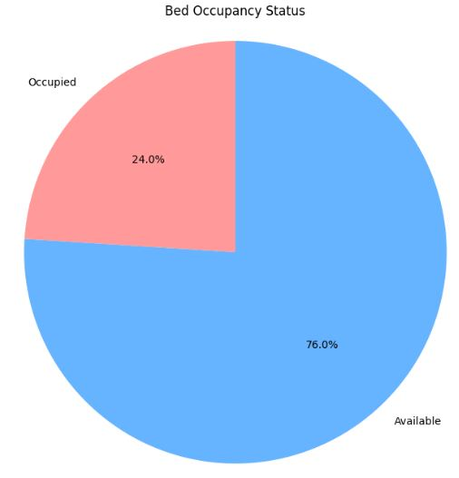
Output

Slide 22
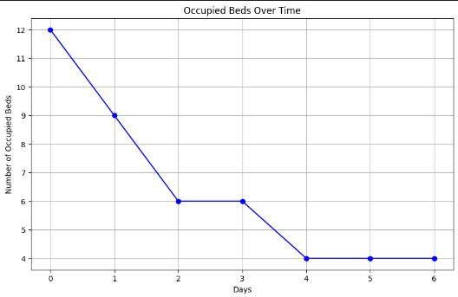
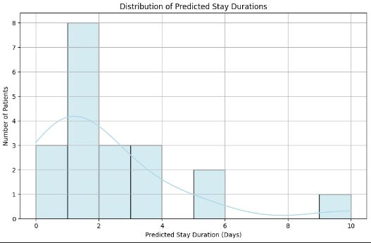
Output

Slide 23
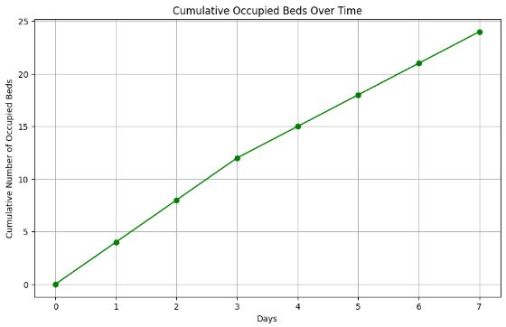
Output

Slide 24
References.
[1] Aboagye-Sarfo P, Mai Q, Sanilippo FM, Preen DB, Stewart LM,
Fatovich DM (2015) A comparison of multivariate and univariate time series approaches to modelling and forecasting emer_x0002_gency department demand in western Australia. J Biomed
Inform 57:62–73
[2] Adan I, Bekkers J, Dellaert N, Vissers J, Yu X (2009) Patient mix
optimisation and stochastic resource requirements: a case study
in cardiothoracic surgery planning. Health Care Manag Sci
12(2):129

Slide 25
References.
[3] Ahmed MA, Alkhamis TM (2009) Simulation optimization for an
emergency department healthcare unit in Kuwait. Eur J Oper Res
198(3):936–942
[4] Majzoubi F, Bai L, Heragu SS (2012) An optimization approach D dispatching and relocating EMS vehicles. IIE Trans Healthc Syst
Eng 2(3):211–223
[5] Nezamoddini N, Khasawneh MT (2016) Modeling and optimization
of resources in multi-emergency department settings with patient
transfer. Oper Res Health Care 10:23–34

Slide 26
Thank You

